Slide 1
Data Centric RAD
Bachelor of Science (Honours) in Computing in Software Development
Bachelor of Science in Computing in Software
Development
Department of Computer Science & Applied Physics

Slide 2
JDBC
JDBC – Java DataBase Connectivity
JDBC is a Java API (Application Program Interface) for database-independent connectivity between Java and a range of databases.
JDBC
Database
Java Application
Local
Or
Remote

Slide 3
JDBC
JDBC provides access to many databases such as MySQL, Sybase, Oracle…
…via a standard API.
Develop code to the API, not the individual database.
Build custom MySQL statements
Select, insert, update, delete
Joins (Inner & Left)

Slide 4
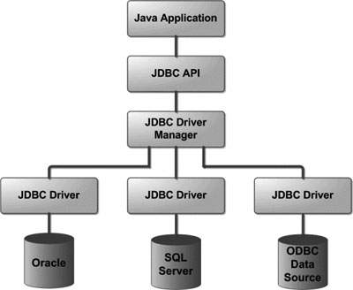
JDBC Architecture
JDBC

Slide 5
JDBC Architecture
JDBC API
Defined in the java.sql and javax.sql packages
Key Classes & Interfaces
Driver Manager
This class manages a list of database drivers.
It matches connection requests from the java application with the proper database driver.

Slide 6
JDBC Architecture
Driver
This interface handles the communications with the database server.
You will interact directly with Driver objects very rarely. Instead, you use DriverManager objects, which manage Driver objects.
Connection
This interface contains methods for contacting a database.
The connection object represents a connection (session) with a specific database.
All communication with the database is through connection object only.

Slide 7
JDBC Architecture
Statement
Used to submit single SQL statements to the database i.e. ones that won’t be executed multiple times. E.g. Creating or dropping a table.
PreparedStatement
Used when a statement will be submitted to the database multiple times.
Can accept parameters.

Slide 8
JDBC Architecture
ResultSet
The ResultSet holds data retrieved from a database after you execute an SQL query using Statement or PreparedStatement objects.
SQLException
Handles any errors that occur in a database application.

Slide 9
JDBC Architecture

Slide 10
JDBC Architecture
JDBC Driver Manager
Manages the set of JDBC drivers that are available for an application to use.
These drivers are loaded when the DriverManager is initialized.
When the getConnection() method is called, the DriverManager attempts to locate a suitable driver based on the parameters passed.

Slide 11
JDBC Architecture

Slide 12
JDBC Architecture
JDBC Driver
Enables a Java application to interact with a database.
A different driver is required for each database.
Database vendors provide JDBC compliant drivers for their particular database.
The JDBC Driver for MySQL is Connector/J.

Slide 13
JDBC Architecture – JDBC Driver Types
JDBC Driver Types
Type 1: JDBC-ODBC Bridge Driver
What is ODBC?
Open DataBase Connectivity (ODBC) is an API used for accessing DataBase Management Systems.
It was developed in the early 1990s to create a standard means of communication between applications and databases.
ODBC is platform, language and database independent.
The functions in the ODBC API are implemented by developers of DBMS-specific drivers.
Applications call the functions in these drivers to access data in a DBMS-independent manner.
A Driver Manager manages communication between applications and drivers.

Slide 14
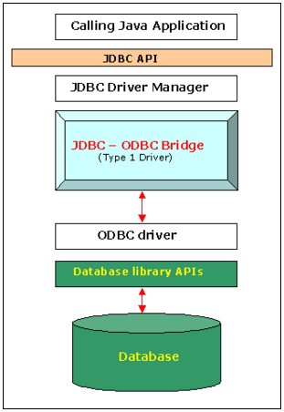
JDBC Architecture – JDBC – ODBC Bridge Driver
Employs an ODBC Driver to Connect to the DBMS.
The driver converts JDBC method calls into ODBC function calls.
No longer used for new applications.
Advantages
Any database for which an ODBC driver is installed can be accessed.
Disadvantages
Performance poor due to calls having to pass through multiple layers.
ODBC Driver needs to be installed on client.

Slide 15
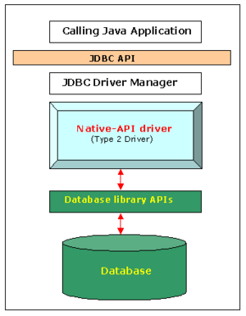
JDBC Architecture – JDBC – Native API Driver
Type 2: JDBC – Native API Driver
JDBC API calls are converted into native C/C++ API calls, which are unique to the database.
These drivers are provided by the database vendors.
Used when Type 3 or Type 4 drivers not available for the used database.
Advantages
Much faster than Type 1 Driver due to the fact that there is no translation of methods to ODBC.
Disadvantages
Driver is platform dependent.
Driver needs to be installed on client.

Slide 16
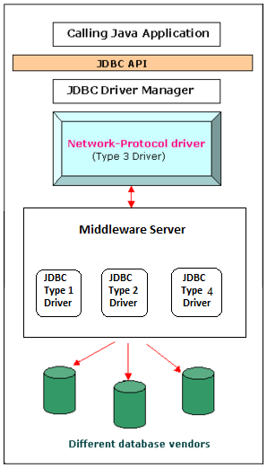
JDBC Architecture – JDBC – Network Protocol Driver
Type 3: JDBC – Network Protocol Driver
The JDBC clients use standard network sockets to communicate with a middleware application server.
The socket information is then translated by the middleware application server into the call format required by the DBMS, and forwarded to the database server.
Used when accessing multiple types of database at the same time.
Advantages
Since the communication between client and the middleware server is database independent, there is no need for the database vendor library on the client.
The single Network Protocol Driver can provide access to multiple databases.
Disadvantages
Requires database-specific coding to be done in the middle tier.

Slide 17
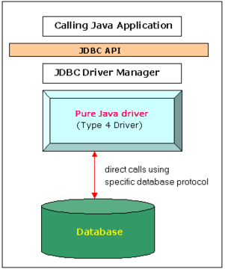
JDBC Architecture – JDBC – Pure Java Driver
Type 4: JDBC – Pure Java Driver
Converts JDBC calls directly into a vendor-specific database protocol.
These Drivers are written in Java and thus are platform independent.
These Drivers are provided by database vendors.
MySQL’s Connector/J is a Type 4 driver.
Used when accessing only one type of database.
Advantages
Platform independent.
No translation of requests to an intermediate format, unlike JDBC-ODBC drivers.
Client connects directly to DBMS, so no middleware is needed, unlike JDBC-Network Protocol drivers.
Disadvantages
Drivers are database dependent.

Slide 18
JDBC
Using JDBC to connect to and interact with a database involves the following steps:
Establish a Connection
Create a Statement
Execute the Query (or the Update)
Process the Result
Close the Connection

Slide 19
JDBC
Using JDBC to connect to and interact with a database involves the following steps:
Establish a Connection
Create a Statement
Execute the Query (or the Update)
Process the Result
Close the Connection

Slide 20
1. Establish a Connection
Establish a connection with the data source you want to use, typically a DBMS with a corresponding JDBC driver.
There are two ways of connecting to the data source (database):
DriverManager
DataSource
This is the preferred way because it allows details about the underlying data source to be transparent to your application.

Slide 21
1. Establish a Connection
Using DataSource objects to get a connection.
Create an instance of the DataSource class.
(For MySQL, the DataSource Interface is implemented as com.mysql.jdbc.jdbc2.optional.MysqlDataSource)
mysqlDS = new MysqlDataSource();

Slide 22
1. Establish a Connection
Set its properties
Need a connection string in the form of a JDBC URL
jdbc:<driver protocol>:<driver connection details>
For example, when connecting to a database called employees on the local machine:
jdbc:mysql://localhost:3306/employees

Slide 23
1. Establish a Connection
mysqlDS = new MysqlDataSource();
mysqlDS.setURL("jdbc:mysql://localhost:3306/employees");
mysqlDS.setUser("root");
mysqlDS.setPassword("");

Slide 24
1. Establish a Connection
The Connection object is located in the java.sql.Connection package and is initialised using the DataSource object as follows:
Connection conn = mysqlDS.getConnection();

Slide 25
JDBC
Using JDBC to connect to and interact with a database involves the following steps:
Establish a Connection
Create a Statement
Execute the Query (or the Update)
Process the Result
Close the Connection

Slide 26
2. Create a Statement
The Statement object is used for executing a static SQL statement and returning the results it produces
It is located in the java.sql.Statement package and is initialised using the Connection object as follows:
Statement myStmt = conn.createStatement();

Slide 27
2. Create the Statement
Write the SQL query as a String, for example:
String query =
“select * from departments”;

Slide 28
JDBC
Using JDBC to connect to and interact with a database involves the following steps:
Establish a Connection
Create a Statement
Execute the Query (or the Update)
Process the Result
Close the Connection

Slide 29
3. Execute the Query
The query is executed by calling the executeQuery() method as follows:
ResultSet rs = myStmt.executeQuery(query);
A ResultSet object is a table of data representing a database result set, which is usually generated by executing a statement that queries the database.

Slide 30
3. Execute the Query
A default ResultSet object is not updatable and has a cursor that moves forward only.
Thus, you can iterate through it only once and only from the first row to the last row.
It is possible to create ResultSet objects that are scrollable and/or updatable:
Statement stmt = con.createStatement(
ResultSet.TYPE_SCROLL_INSENSITIVE, ResultSet.CONCUR_UPDATABLE);

Slide 31
Inserts, Updates, Deletes
As well as simply querying a database, an application will also need to Insert new data, update existing data and delete old data.
In these instances, we call the executeUpdate method instead of the executeQuery method.

Slide 32
Insert
String name = "Joker";
String fName = "Jack";
String sName = "Nicholson";
String dob = "1949-03-21";
double powers = 89.4;
String sql = "insert into superhero_table values(" +
"'" + name + "', " +
"'" + fName + "', " +
"'" + sName + "', " +
"'" + dob + "', " +
"'" + powers + "')";
myStmt.executeUpdate(sql);

Slide 33
Delete
String name = "Joker";
Statement myStmt = conn.createStatement();
String sql = "Delete from superhero_table " +
"where name like '" + name + "'";
myStmt.executeUpdate(sql);

Slide 34
Update
String name = "Joker";
String sql = "Update superhero_table " +
"set powers = powers + 1 " +
"where name like '" + name + "'";
myStmt.executeUpdate(sql);

Slide 35
JDBC
Using JDBC to connect to and interact with a database involves the following steps:
Establish a Connection
Create a Statement
Execute the Query (or the Update)
Process the Result
Close the Connection

Slide 36
4. Process the Result
You access the data in a ResultSet object through a cursor.
This cursor is a pointer that points to one row of data in the ResultSet.
Initially, the cursor is positioned before the first row.
The method ResultSet.next() moves the cursor to the next row.
This method returns false if the cursor is positioned after the last row.
The next() method can be used in a while loop to iterate through a ResultSet.

Slide 37
4. Process the Result
The ResultSet interface declares getter methods (for example, getBoolean and getLong) for retrieving column values from the current row.
You can retrieve values using either the index number of the column or the alias or name of the column.

Slide 38
3. Process the Result
ResultSet rs = myStmt.executeQuery(query);
while( rs.next() ) {
int sNumber = rs.getInt("S_NO");
String sTown = rs.getString("S_Town");
System.out.println("Number = " + sNumber);
System.out.println("Town = " + sTown);
}

Slide 39
JDBC
Using JDBC to connect to and interact with a database involves the following steps:
Establish a Connection
Create a Statement
Execute the Query (or the Update)
Process the Result
Close the Connection

Slide 40
5. Close the Connection
After use, the Connection as well as any Statements or ResultSets should be closed.
conn.close();
myStmt.close();
rs.close();

Slide 41
Exceptions
When JDBC encounters an error during an interaction with a data source, it throws an instance of SQLException as opposed to Exception.
The exact message can be found by using the getMessage() method.
catch( SQLException se ) { System.out.println(se.getMessage());
}

Slide 42
SQLExceptions
Exceptions are in the com.mysql.jdbc.exceptions.jdbc4 package.
The following are examples of common SQLExceptions:
CommunicationsException
The Database is offline/or the communication link down.
MySQLIntegrityConstraintViolationException
Trying to insert an already existing Primary Key
Trying to delete a row containing a column which is referenced in another table

Slide 43
All Together
try {
myqlDS = new MysqlDataSource();
mysqlDS.setURL("jdbc:mysql://localhost:3306/employees");
mysqlDS.setUser("root");
mysqlDS.setPassword("root");
Connection conn = mysqlDS.getConnection();
Statement myStmt = conn.createStatement();
String query = "select * from departments";
ResultSet rs = myStmt.executeQuery(query);
while( rs.next() ) {
int sNumber = rs.getInt("S_NO");
String sTown = rs.getString("S_Town");
System.out.println("Number = " + sNumber);
System.out.println("Town = " + sTown);
}
} catch( SQLException se ) {
System.out.println(se.getMessage());
}

